Slide 1
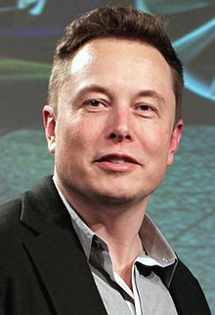
Elon Musk

Slide 2
WHO IS ELON MUSK?

Slide 3
Elon Reeve Musk (born June 28, 1971) is a South African-born Canadian American business magnate, investor, engineer and inventor.
Elon Musk is known for his futuristic ideas.
Numerous passions inspired Musk, and today he manages companies and projects that specialize in electric and self-driving cars, private space exploration and Mars colonization, solar energy and artificial intelligence.

Slide 4
CAREER
Zip 2 (1995)
X.com (1999) and PayPal
SpaceX (2002)
Tesla (2003)
SolarCity(2016)
Hyperloop
OpenAI
Neuralink
The Boring Company

Slide 5
The Boring Company

Slide 6
What is this?
The Boring Company (TBC) is an infrastructure and tunnel construction company founded by Elon Musk in late 2016.
To alleviate traffic, transportation corridors.
There is no practical limit to how many layers of tunnels can be built, so any level of traffic can be addressed.
Tunnels are weatherproof.
Tunnel construction and operation are silent and invisible to anyone on the surface.
Tunnels don’t divide communities with lanes and barriers.
Why tunnels?

Slide 7
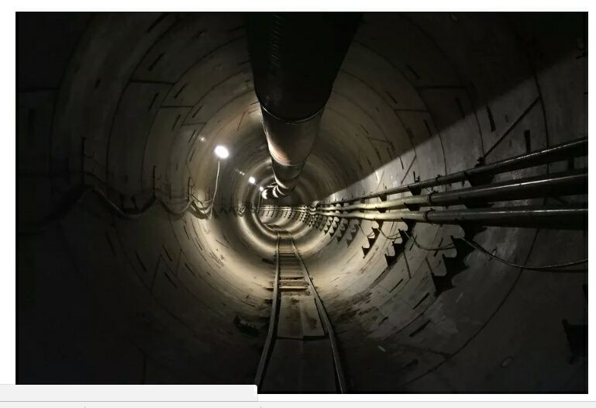
Musk has picked LA as the testing ground both because he works in nearby Hawthorne and because the city’s notorious traffic jams gives the Boring Company a clear-sighted target.

Slide 8
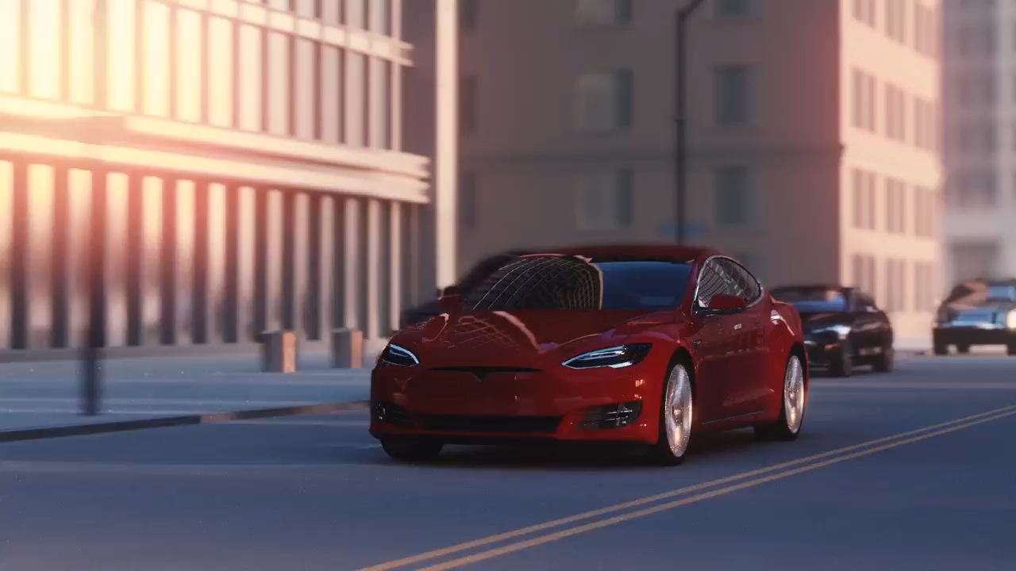
The Boring Company | Tunnels

Slide 9

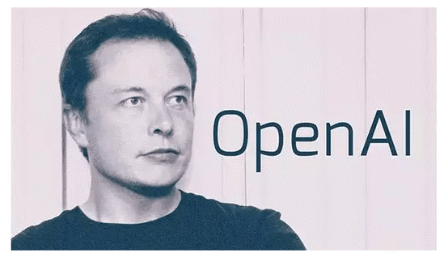
OpenAI is a non-profit research company working to build safe artificial intelligence. 11th December 2015, San Francisco

Slide 10
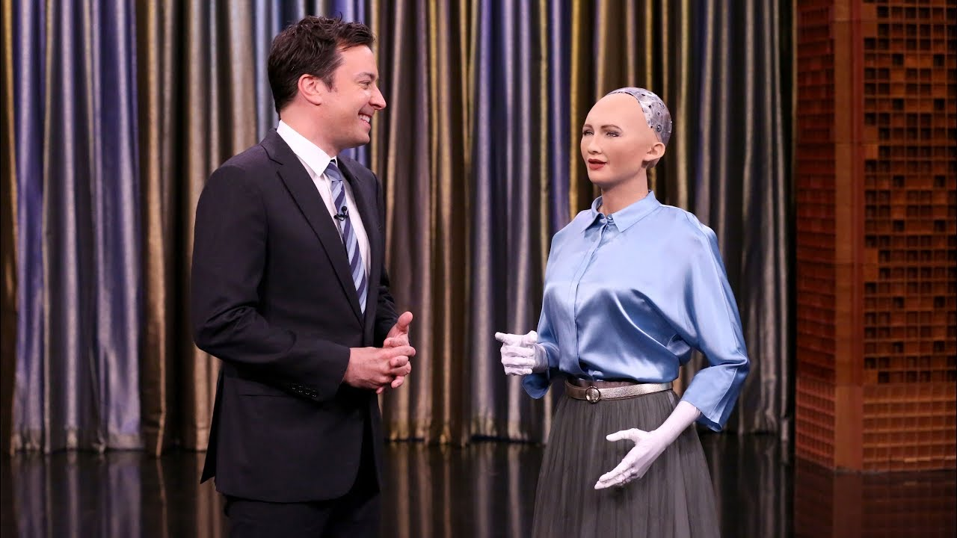

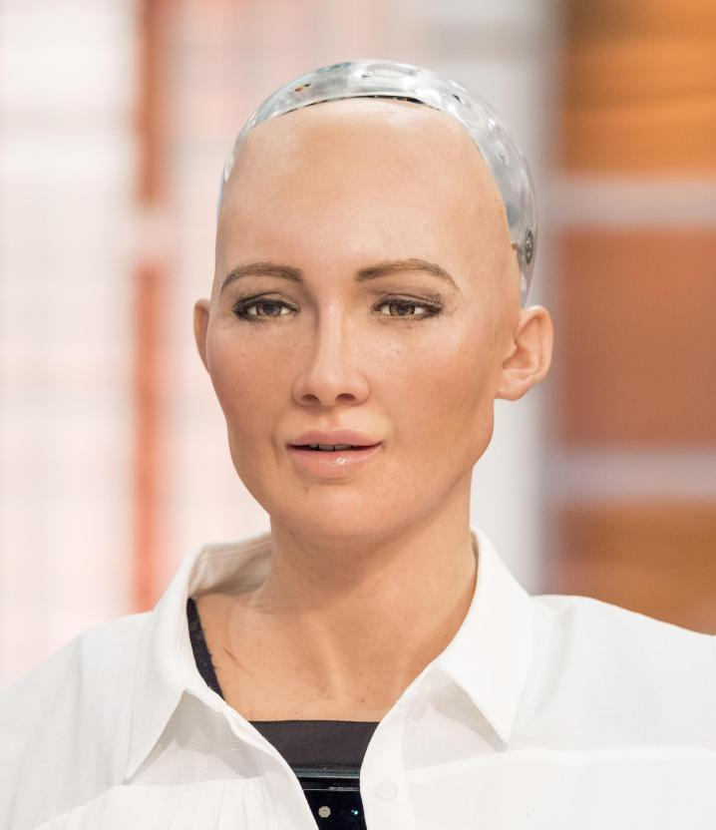
Sophia is a humanoid robot developed by Hong Kong-based company Hanson Robotics.
Elon Musk began warning about the possibility of A.I. behave uncontrollably three years ago.
Mars = a place to escape if A.I. turns against humanity.

Slide 11

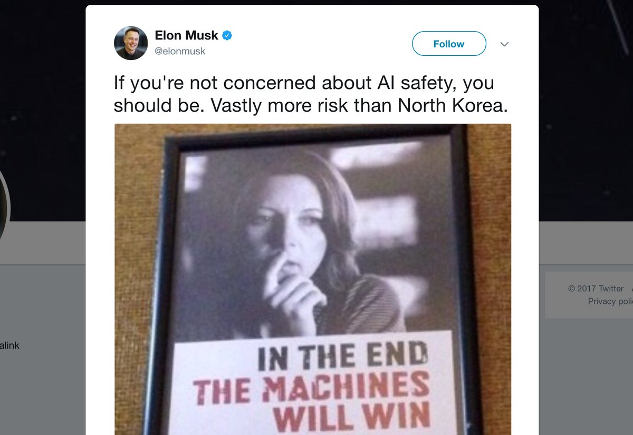
“What will happen is a scientist will get so engrossed in their work that they don’t really realize the ramifications of what they’re doing.”
A.I. is humanity’s “biggest existential threat.”
There should be some national or international regulatory oversight “to make sure that we don’t do something very foolish.”
“With artificial intelligence, we are summoning the demon.”

Slide 12
